Slide 1
Use of Digital Technology to calculate water footprints for different daily use items
CSE7101- Capstone Project
Review-1
Batch Number: IST_27
Under the Supervision of,
Mr.Saptarsi Sanyal
MS.Monisha Gupta
Assistant Professor
School of Computer Science and Engineering
Presidency University
Roll Number | Student Name
2O221IST0017 | Bolla Sagarika
20221IST0002 | Gandavaram Sravanthi
20221IST0003 | Bathina Mounika
Name of the Program: IST
Name of the HoD: Dr. Pallavi R
Name of the Program Project Coordinator: Dr.Afroz Pasha
Name of the School Project Coordinators: Dr. Sampath A K , Dr. Geetha A

Slide 2
Problem Statement Number:
Organization: Aiming to create impactful digital solutions that contribute to sustainable development goals, specifically addressing global water conservation issues.
Category: Software – Web-based learning platform
Problem Description: Water scarcity is a growing global concern, affecting billions of people annually. A significant share of water consumption is hidden in the production of goods (water footprint).
The solution will help individuals, organizations, and policymakers: Identify hidden water usage.

Slide 3
CONTEXT
Water is a finite resource: Only about 2.5% of the Earth’s water is freshwater, and much of it is locked in glaciers and ice caps. With rising population and industrialization, the demand for freshwater is increasing rapidly. Hidden water use: Most people are unaware of the amount of water consumed indirectly in making the products they use every day—such as food, clothing, paper, or electronics. This indirect consumption is known as the water footprint. Need for awareness: For example, producing a single cotton t-shirt can use over 2,700 liters of water, while one cup of coffee may require 140 liters of water during its production chain. Such facts highlight the urgency of measuring and managing water footprints. Role of digital technology: With the rise of data analytics, IoT sensors, mobile apps, AI, and cloud computing, digital tools now allow us to estimate, track, and visualize water footprints more accurately. They can connect consumers, industries, and policymakers with real-time information.

Slide 4
OBJECTIVES:
Develop a digital solution to estimate the water footprint of various daily use items with high accuracy. Integrate relevant datasets (e.g., production processes, regional water usage statistics) into a centralized system for footprint calculation. Design a user-friendly interface that allows individuals and organizations to easily input items and receive water footprint results. Increase awareness about the hidden water usage in everyday products through interactive visualizations and reports. Support sustainable decision-making by providing actionable insights to reduce water consumption.

Slide 5
Background and Related work for tittle Selection:
Freshwater is a finite resource, with only about 2.5% of Earth’s total water being available for human use. A large proportion of this is consumed indirectly through the production of goods, referred to as the water footprint. According to UNESCO and Water Footprint Network studies, the production of common daily items—such as clothing, food, and electronics—can require thousands of liters of water.
Existing water footprint calculation methods are often: Manual and time-consuming – requiring extensive research into production chains. Lacking accessibility – technical data is not easily available to the general public. Regionally inconsistent – variations in agricultural and industrial water usage are not always considered. Previous works, such as the Water Footprint Calculator by the Water Footprint and mobile apps for carbon footprint estimation, have shown that digital platforms can successfully raise awareness and encourage behavioral change.

Slide 6
Analysis of Problem Statement
Technology Stack Components
Data Availability and Reliability Water usage data for various products is scattered across research papers, government databases, and industrial reports. Data sources often differ in methodology, making it difficult to create a standardized model. Regional Variations The water footprint of the same item can vary significantly depending on production location due to climate, agricultural practices, and industrial efficiency. A dynamic system must factor in regional parameters for accurate results. User Awareness and Accessibility Most consumers are unaware of the indirect water consumption embedded in their daily choices. Without a simple, engaging platform, public participation in footprint tracking remains low.
Integration of Digital Technologies Cloud-based systems, APIs, and databases can enable real-time, scalable calculations.

Slide 7
Innovation or Novel Contributions:
Comprehensive Item Database Covers a wide range of daily use items, from food products to clothing to electronics, with their associated water
footprint values. Region-Specific Calculations Incorporates geographic and climatic variations to produce location-adjusted water footprint estimates. Real-Time Digital Computation Uses cloud-based processing and API integrations to provide instant calculations for user inputs. Interactive Visualization Tools Employs charts, infographics, and comparative visuals to make water footprint data intuitive and engaging. User-Centric Design Simple interface designed for both general consumers and policy researchers, enabling broad accessibility.

Slide 8
Github Link
The Github link provided should have public access permission.
Github Link
https://github.com/sagarikabolla
https://github.com/sagarikabolla/Capstone-project

Slide 9
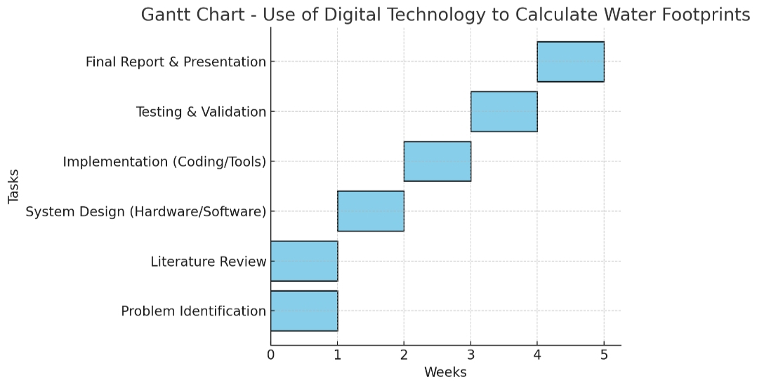
Timeline of the Project (Gantt Chart)

Slide 10
References (IEEE Paper format)
[1]Laura Montano, Philippe Gourbesville :- IAHR Global Water Institutes, From Data to Decisions: The Digital Accelerators for Water Management, IAHR Global Water Institutes Report, 2025. DOI: 10.3850/IAHR-GWIR2025-001 Liahr.org
[2]A. Mishra, and S. Dubey, “Use of Digital Technology to Calculate Water Footprints for Different Daily Use Items,” Int. J. Innov. Res. Adv. Eng., vol. 11, no. 05, pp. 668–675, May 2024. DOI: 10.26562/ijirae.2024.v1105.36.

Slide 11


